Slide 1

Monroe County Proposed Jail
Informational Session
Notes:
S

Slide 2
Hello!
We are Care Not Cages, a grassroots organization that has been fighting the current jail proposal since 2022. Our core value is that we believe communities are best served by Care, not Cages - hence the name! How that manifests in Monroe County’s specific moment is that we believe our county should renovate the existing jail and invest in community-based substance use treatment, our collective physical and mental health, housing, and transportation instead of a massive new jail.
Notes:
S

Slide 3
We’ll talk about
The situation with our current jail in the Charlotte Zietlow Justice Building
The ACLU lawsuit against the County
The studies and plans that have led to the current proposed design
The changes to state tax law that affected the project funding
Current politics and the decision-makers
Alternatives to a new bigger jail
How you can get involved!
Notes:
S

Slide 4
The Charlotte Zietlow Justice Building
Centrally located in downtown Bloomington
Houses the courts, clerk’s office, prosecutor’s office, early voting, and other offices and public services in addition to the county jail, 91,222 square feet total
Fell into disrepair and has a history of overcrowding and poor conditions in jail
Has had issues with mold and other manifestations of neglect
The jail has 294 beds and is the largest provider of mental health services in Monroe and surrounding counties
Built in 1985–only 40 years old
Notes:
C

Slide 5
The ACLU Lawsuit
Filed in 2008 as a class action suit on behalf of incarcerated people living in the jail and facing atrocious conditions and overcrowding
An annually renewable settlement agreement requires Monroe County to maintain acceptable conditions, not build a new jail
Average daily populations in the jail this year have stayed under capacity around 230
Notes:
C Presenter Note: Contrary to what is commonly presented, the settlement agreement is not about building a bigger jail or about conditions. The settlement agreement almost entirely is regarding jail capacity. It states that the county must attempt to keep the population of those in security beds below 248. If it goes above 248, they have to either release inmates or transfer inmates to other county’s jails and pay a per diem rate. That is a requirement, and it requires that prisoners are given at least two weeks exercise per week. Nowhere in the settlement does it state that they must build a new jail!

Slide 6
The ACLU Lawsuit
From a legal memo put out by members of the National Lawyers Guild:
“While a new jail would be a solution that would satisfy the ACLU, it is not the only option. As long as the current jail meets the standards of CRIPA [Civil Rights of Institutionalized Persons Act], a new jail is not necessary. In addition, the court could never order the county to build a new jail, so this would have to be on the county’s own volition and a part of their settlement agreement.”
Notes:
C

Slide 7
2021 - 2023
2021: County commissions two studies about jail and criminal legal system. One study says “the jail has far exceeded its structural and functional life cycle” but claims the reason for this is that renovation would be “cost prohibitive at a provisional estimated cost exceeding 56 million dollars,” despite that being a quarter of the cost of new construction. The second study focuses not on the jail but on the litany of other ways to reduce incarceration such as treatment and policy changes.
2022: County tries to build a new jail near Monroe Hospital. Public outcry about location leads to City Council denying rezone in 9-0 vote.
2023: Sheriff Marte gives presentation on poor conditions of jail and begins work of cleaning and repairing facility.
Notes:
S Speaker Notes: There is a lot of history surrounding incarceration in our county. This topic really came back into discussion in 2021. There is far too much to discuss in great detail in our short amount of time, but to share just some highlights…

Slide 8
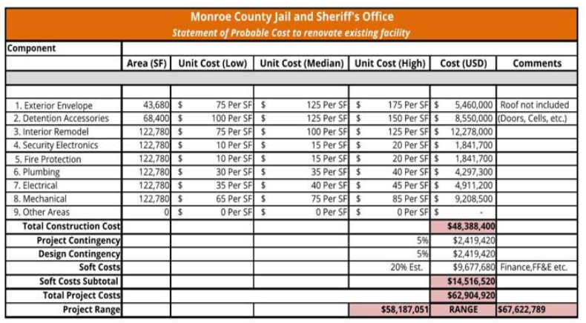
RQAW Study - Monroe County Justice Study (2024)
Report published April 29, 2024
RQAW one of top jail design firms in Indiana
Studied existing jail and found full renovation cost to be $62.9 million
Housing inmates out of county, transporting them in and out, and relocating courts for two years of renovation estimated to cost $16.6 million
Total renovation and relocation cost: $79.5 mil
Notes:
S

Slide 9
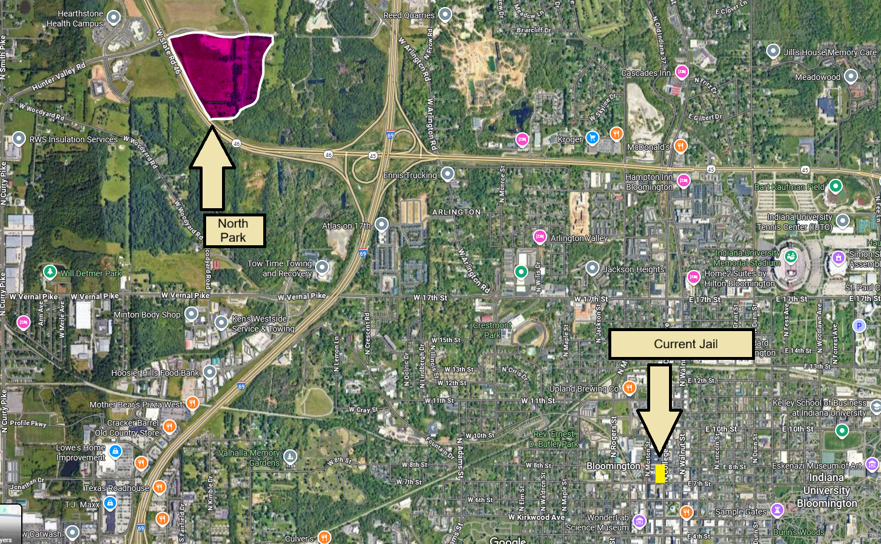
The Land - North Park
The site is west of town along SR 46 near Ellettsville
Comes at an $11 million price tag
Purchase agreement is in place, but the County has not closed on the sale
3.9 miles from current jail (98 minute walk)
Not accessible by public transportation
Co-locating services (clerk’s office, early voting, traffic courts, etc) makes them inaccessible except by car
Notes:
S

Slide 10
Pre-design Phase Plan (February 2025)
500 beds (41% increase over current jail, while County Council adopted a policy position of no larger than 400 beds)
271,000 sq ft (3x the size of current)
Design firm DLZ would make 10% of construction cost, so they stand to benefit from a larger facility
Plan did not include outdoor recreation area or space for inmate resources
Two-floor plan (a one-floor plan was sold to the community as a necessity and a reason to vacate current building)
Construction cost of $237 million
Notes:
S

Slide 11
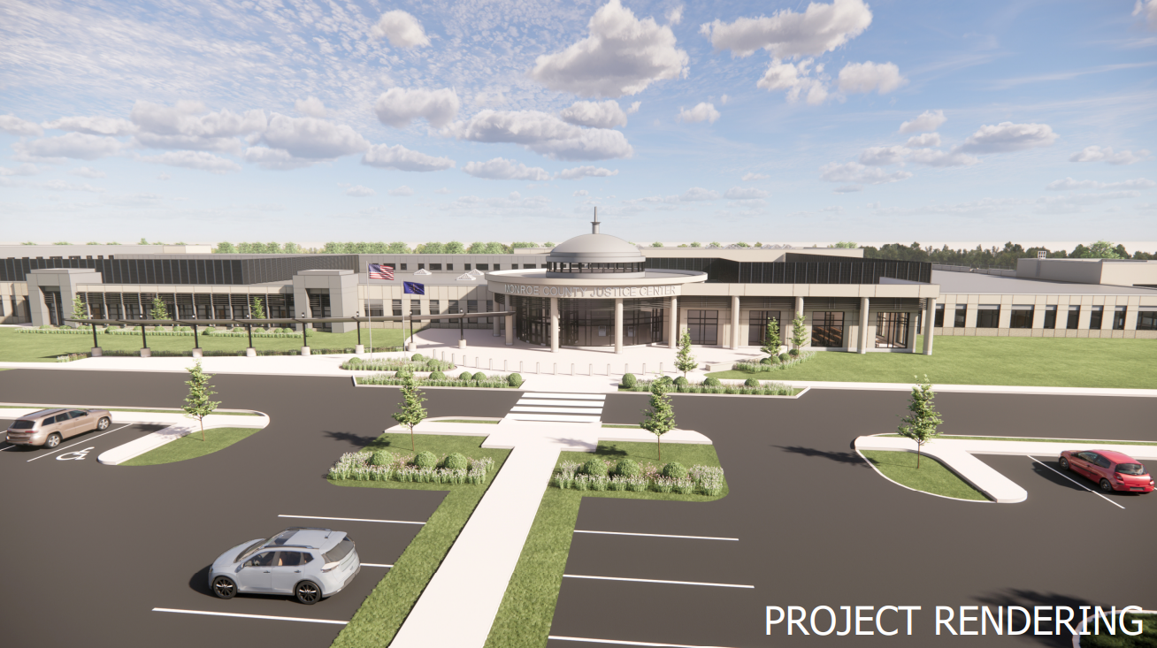
Schematic Design Plan (August 2025)
Cost of $224.5 million (only 5% reduction)
13% reduction of gross square footage
Space for 500 beds, 404 immediately built out, plus additional expansion opportunities
Assumes increased incarceration while we have a stagnant population and decreasing violent crime
Tiny outdoor recreation space added
Over 600 parking spaces
Notes:
S

Slide 12
Wait a minute…. what about renovation?
Notes:
S

Slide 13
The core comparison
$225 Million to build a new jail….
versus
$62 Million to fix the one we’ve got
Notes:
S/C

Slide 14
The Money
Notes:
C

Slide 15
SEA 1
(Property Tax Reform)
Sold as a tax cut for everyday Hoosiers by the Republican party, it was the biggest legislative priority this past session
By cutting property taxes, the expectation is that counties will more heavily rely on local income tax (LIT)
It also included limits for LIT used for debt repayment (as more of a county’s LIT will be needed to provide basic services)
Indiana State law passed 2025
Notes:
C

Slide 16
How SEA 1 has affected this project
Prior to SEA 1, County could have financed $243 mil for jail project by using almost half its total Local Income Tax for the next 20 years.
Under current law, County can only bond $19.3 mil for the next 2 years
County Council member David Henry likened this to “maxing out the county credit card for 20 years.”
Attempting to move forward with a $225 million project at this time completely hobbles our County’s ability to keep a balanced budget and provide basic services
Notes:
C

Slide 17
Hidden Costs
Interest totaling about $100 mil
Cost of demolishing or repurposing the Charlotte Zietlow building (unknown)
Increased maintenance and operating costs of a much larger facility with landscaping, parking lot
Economic impact of vacating downtown, effect on restaurants and local businesses which benefit from the presence of workers and citizens
Notes:
C

Slide 18
As the project currently stands, the only way to fund it is through change to state tax law and/or a referendum put to voters.
Notes:
C

Slide 19
Over $300 million
What could our community do if that kind of money went to services?
Notes:
S

Slide 20
Over $300 million
Annual Expenses:
Beacon (Shalom, Crawford, Friend’s Place, Rapid Rehousing): $2,956,137 (0.98%)
Mother Hubbards Cupboard: $630,413 (0.2%)
New Leaf, New Life: $147,341 (0.04%)
Middle Way House: $2,531,078 (0.84%)
Indiana Recovery Alliance: $744,157 (0.24%)
The $163 million savings between a new jail and renovation could fully fund these five organizations for twenty-three years!
Notes:
S

Slide 21
The People
Notes:
C

Slide 22
County Government
County Council - Approves budgets, handles county money
Peter Iversen (President Pro Tempore, District 1)
Kate Wiltz (District 2)
Marty Hawk (District 3)
Jennifer Crossley (President, District 4)
Trent Deckard (at-large)
Liz Feitl (at-large)
David Henry (at large)
County Commissioners - Administrative and policy tasks, authorize contracts, maintain County property, appoint board and commission positions
Lee Jones (District 1)
Julie Thomas (President, District 2)
Jody Madeira (District 3)
Find your district at in.gov/counties/monroe
Notes:
C

Slide 23
Current Positions
County Council is aware there is no way to pay for project as things currently are
In meetings, they have all expressed reservations with the plans but have been hesitant to take a public stand
Council has less power, but could still choose to not fund a Commission-approved project
County Commissioners are the main force driving the jail project
The Commissioners have the power to approve projects and contracts and keep pushing forward (approved schematic design on Sept 4)
They seem to be relying on the possibility for a change to SEA 1, which is not likely
Notes:
C

Slide 24
Sheriff Ruben Marté
Since taking office, he’s made many repairs to the jail and has kept numbers below capacity
He has been quoted as saying that he does not wish to incarcerate more people and wants a larger jail for more programming space (which is not in line with plans)
He has been publicly advocating for a new facility
Began serving in 2023
Notes:
C

Slide 25
Current Coalition-building
New Leaf New Life authored a statement in opposition to the jail project
12 organizations have signed on in support
Presented to the County Council at July 22 meeting
“Evidence-based research has proven that new jails do not solve the systemic issues driving incarceration in our area — including poverty, lack of affordable housing, and untreated mental health or substance use disorders. [...] Expanding the jail [does] not reduce recidivism or improve community safety — but investing in services like ours does.”
Notes:
S

Slide 26
Us!
We have a say in what happens in our community!
Our Commissioners, Council, and Sheriff WORK FOR US.
These buildings are OURS, this money is OURS, what our community could look like moving into the future is for US to decide.
Notes:
S

Slide 27
What now?
Notes:
S

Slide 28
Ideally…
Renovate the existing jail for an estimated $62 million
Maintain it and continue to meet the standards of CRIPA (Civil Rights of Institutionalized Persons Act)
Change policy to divert people from jail: eliminate stringent and punitive probation requirements, reduce drug testing, increase use of release on recognizance
Invest in housing, mental health and substance use treatment, and the services which actually keep our community safer (and are far more cost-effective)
Notes:
S

Slide 29
How to take action
Put massive public pressure on the Commissioners. They are the primary driving force approving the contracts and pushing the project forward.
Put massive public pressure on the Council. They can choose not to fund a project or contract approved by the Commission.
Go to Council and Commission meetings and make public comments
Talk to your friends and neighbors, write op-eds, change the public conversation
Keep in touch with us for updates and action calls!
Notes:
C Get shows of hands for involvement!

Slide 30
Question time!
Notes:
C/S

Slide 31
The very, very short story
The existing jail is in very poor condition but can be renovated and is not actually too small
We can’t pay for a new jail, and trying to would destroy our county’s ability to provide even the most basic services, nevermind investment in social services
Vacating the current downtown building presents increased logistical and economic strains
No one in county government has given a compelling reason as to why renovation is not being considered as an option
So we say: RENOVATE AND INVEST IN SERVICES!
Notes:
C

Slide 32
carenotcages-monroecounty.org
Find links and sources

